Slide 1
Thursday 8/31/17 Success starter☺
Standard: S6E1.f :Describe the characteristics of comets, asteroids, and meteors
Warm up: Explain the difference between a meteor, meteorite, and meteoroid.
https://www.youtube.com/watch?v=O4QrnC9vLs8

Slide 2
Comets
Comets: a dust covered ball made of ice and rock (dirty snowballs).

Slide 3
Comets
Where are they found?
Orbiting the sun.

Slide 4
Comets
Comets: a dust covered ball made of ice and rock (dirty snowballs).
1. These dust covered balls of ice and rock are called a nucleus
2. Something disturbs the comets and sends them streaking toward the sun!

Slide 5
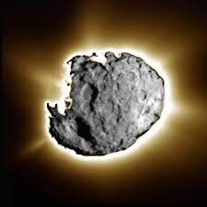
Comets..on their way towards the sun…
3. As the nucleus passes the orbit of Jupiter, it begins to heat up.
4. Some ice inside the nucleus
turns to glowing gas
5. gasses spread out from the nucleus to form an atmosphere around the nucleus called a coma
6. Together, the coma and the nucleus
form the head of the comet

Slide 6
7. As the comet approaches the sun, energy from the sun blows parts of the coma away from the nucleus…..
8. These parts stream away from the head of the comet to form a shimmering tail
A comets tail ALWAYS points away from the sun
Notes:
Regions Where Comets Are Found, Comets Formation Features Of Comet ...The Hubble Space Telescope may have detected a population of small comets ...www.spacestationinfo.com -

Slide 7
Label the parts of the comet!
Nucleus
Tail
Coma
Head

Slide 8
Label the parts of the comet!
Nucleus
Tail
Coma
Head

Slide 9
What is the fate of a comet?
Some comets plunge into the sun
others orbit around the sun one or more times
The most famous returning comet is Halley’s Comet, which comes back approximately every 76 years

Slide 10
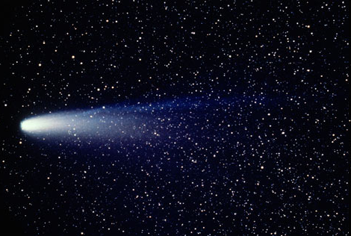
Halley’s Comet
1. Can you see where the nucleus, coma, and tail are?
2. Judging from this picture, where is the sun?

Slide 11
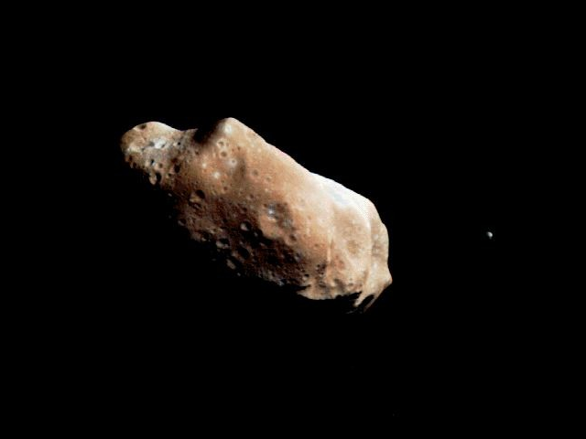
Asteroids
Asteroids are chunks of rock and metal, smaller than Earth’s moon.

Slide 12
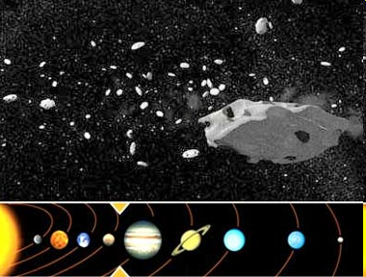
How big do asteroids get?
Most asteroids are less than 1 km in diameter
The largest known asteroid is Ceres (940 km in diameter)

Slide 13
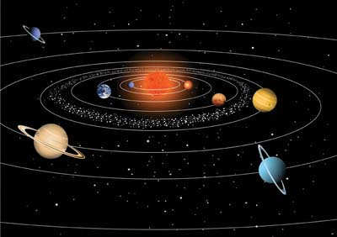
Where are asteroids found?

Slide 14
Where are asteroids found?
orbiting the sun like planets
Most are in a belt between the orbit of Mars and Jupiter (Asteroid Belt)

Slide 15
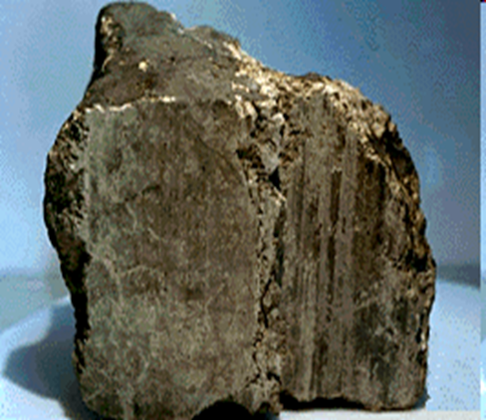
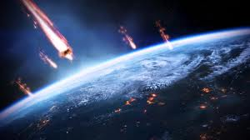
Meteoroids, Meteors, and Meteorites
Meteoroid/meteor/meteorites: space rock made of rock material and metal.
* All of these are the same, but have different names, based on where they are located.

Slide 16
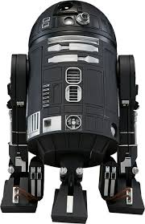
Meteoroids, Meteors, and Meteorites
Meteoroid:
* found in outer space.

Slide 17
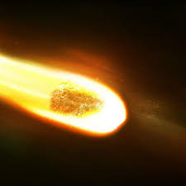
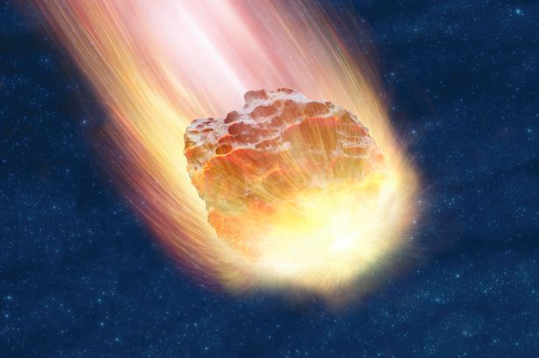
Meteor: name of meteor as it plunges into Earth’s atmosphere.

Slide 18
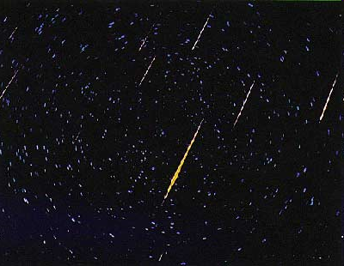
Shooting star: forms when a meteor becomes so hot in Earth’s atmosphere, that some or all of it burns up.
The burning meteor
appears as a streak of light ……
A Shooting Star

Slide 19
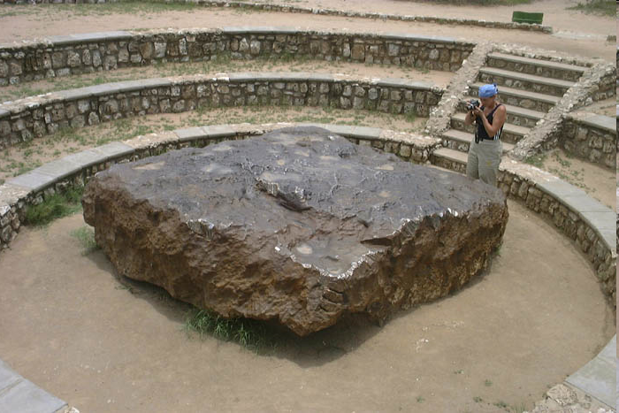
Meteorite: meteor that does not completely burn up in our atmosphere and hits Earth’s surface.
(right at the surface)
Worlds largest meteorite Hoba, found in Namibia

Slide 20
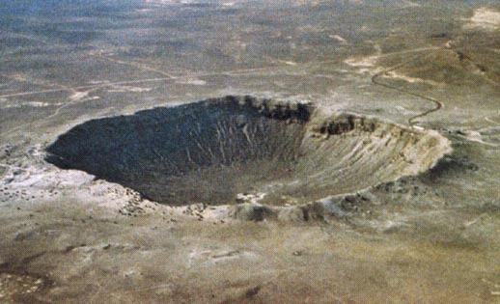
Barringer’s Crater
An iron meteorite 100 feet across and 70,000 tons slamed into the Earth at about 43,000mph in the Arizona desert near Flagstaff 40,000 years ago. Barringer Crater is 4,100 feet wide and 571 feet deep.

Slide 21
Draw the sequence that a meteoroid goes
through……….

Slide 22
Quick Check
Where are most asteroids found?
All over our solar system
In orbit between Mars and Jupiter
Near Earth
Outside of the solar system

Slide 23
Quick Check
What is the sequence that describes a space rock that falls to Earth’s surface?
meteoroid, meteor, meteorite
Meteor, meteoroid, meteorite
Meteorite, meteor, meteoroid
Meteor, meteorite, meteoroid

Slide 24
Quick Check
A chunk of rock and metal, smaller than Earth’s moon_____.
Meteoroid
Meteor
Asteroid
comet

Slide 25
Quick Check
A space rock made of rock and metal that is burning up as it plunges through Earth’s atmosphere.
Meteoroid
Meteor
Asteroid
comet

Slide 26
Quick Check
A space rock made of rock and metal that hits Earth’s surface
Meteoroid
Meteor
Asteroid
meteorite

Slide 27
Quick Check
A space rock made of rock and metal that hangs out in outer space.
Meteoroid
Meteor
comet
meteorite

Slide 28
Quick Check
A space rock made of rock and metal that hangs out in outer space.
Meteoroid
Meteor
comet
meteorite

Slide 29
Quick Check
A space rock found orbiting between Mars & Jupiter.
Meteoroid
Meteorite
Asteroid
comet

Slide 30
Quick Check
When a space rock of rock and metal plunges into Earth’s atmosphere, it is called a _________.
Meteoroid
Meteorite
Asteroid
comet

Slide 31
Where is found here?
Comets
Meteors
Asteroids
meteoroids

